Slide 1
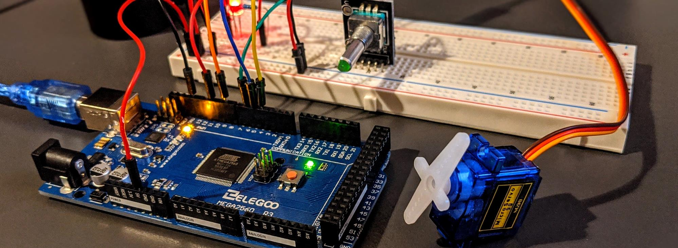


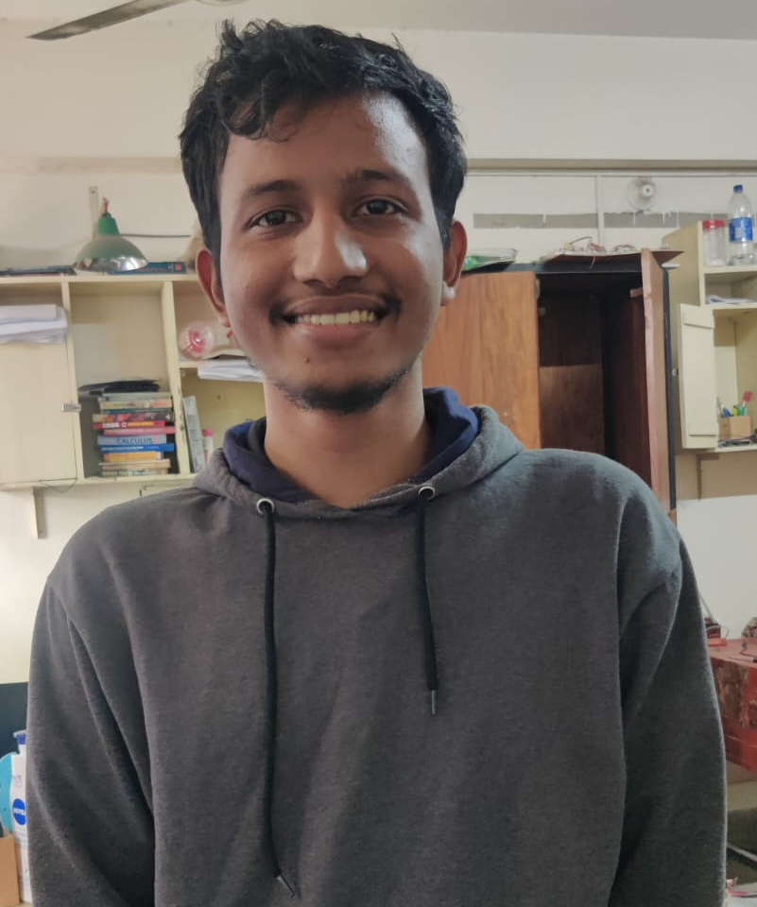

IoT Based Water Quality Monitoring
EEE 416 – Microprocessor and Embedded System Laboratory
July 2023 Level-4 Term-1 Section A
Project Progress
Submitted by – Group A.02
Muzakkir Ahmed
1906002
Md.Rowatul Jannat Rafi
1906016
Md.Tareq Mahmud Rakib
1906024
Mithon Rahman
1906028

Slide 2
Outline
Abstract
Introduction
Components
Methodology
Progress
Complexity
Future Work
Presented by: 1906002

Slide 3
1. Summary / Abstract
A project aims to ensure the hygienic safety of drinking water and household tasks by real-time monitoring of water quality parameters like temperature, conductivity, and pH. Samples are collected from household sources, and sensors and microcontrollers measure these parameters for real-time analysis via IoT-based servers. This initiative supports the SDG goal of clean water and sanitation, aiming to minimize water-borne ailments and promote sustainable development.
Presented by: 1906002

Slide 4
2. Introduction
Access to clean drinking water is crucial for sustaining life, recognized as a basic human right and a Sustainable Development Goal (SDG) under SDG 6.
Despite abundant water coverage on Earth, clean drinking water is scarce, with around 771 million people lacking access to safe drinking water.
Bangladesh, despite being a riverine country with abundant rainfall, faces a water crisis.
While 98% of the population has basic water coverage, only 58.5% have access to safely managed water.
Merely 15% of the population have access to piped water supply, with only 2.9% of the poorest quantile having access.
86% of the poorest households' water is contaminated with E. coli, and 16.7% of the population use arsenic-contaminated water.
Presented by: 1906002

Slide 5
2. Introduction (Contd.)
Electrical conductivity of water increases with increase in ion density, and this is indicator of whether TDS value of water has gone up or not. If the density of free ions increase, so does electrical conductivity. But excessive density of free ions in mineral water is an unfavorable phenomenon since it indicates that the sample of water is being contaminated. According to WHO standards, EC value of drinking water should not exceed 400 μS/cm or 0.4 mS/cm and safe range of pH is between 6.5 and 8.5. The best temperature for drinking water is room temperature (20°C / 68°F) for maximum flavor or chilled cold (6°C / 43°F) for maximum refreshment.
Presented by: 1906002

Slide 6
3.1 Design: Problem Formulation (PO(b))
3.1.1 Identification of Scope
The degradation of drinking water quality due to pollution, including heavy metals and acidic or basic solutions, poses health risks and leads to various diseases.
Underground water sources are also affected, highlighting the urgent need for monitoring water quality.
A project has been initiated to address this issue, aiming to find solutions and ensure the safety of drinking water through monitoring and intervention measures.
Presented by: 1906002

Slide 7
3.1 Design: Problem Formulation (PO(b))
3.1.2 Literature Review
IoT-based water quality monitoring systems are effective for real-time surveillance, continuously detecting contaminants.
Advanced analytics models and decision support systems aid in interpreting IoT-generated data, enabling informed decision-making for water management.
Challenges like sensor calibration and data security are recognized, with proposed solutions such as calibration algorithms and encryption techniques.
Overall, literature highlights the crucial role of IoT-based systems in protecting public health and promoting environmental sustainability through efficient water quality management.
Presented by: 1906002

Slide 8
3.1 Design: Problem Formulation (PO(b))
3.1.3 Formulation of Problem
The lack of real-time monitoring systems for drinking water quality poses a significant challenge in ensuring timely detection and mitigation of contaminants.
Existing water quality monitoring methods are often manual, leading to delays in identifying potential health risks and environmental hazards.
There is a pressing need to develop an IoT-based monitoring system that provides continuous surveillance of water parameters, enabling prompt detection of anomalies and facilitating informed decision-making for water management authorities.
Presented by: 1906002

Slide 9
3.1 Design: Problem Formulation (PO(b))
3.1.4 Analysis
The problem formulation identifies the lack of real-time monitoring systems and shortcomings of manual methods in promptly detecting contaminants.
It emphasizes the necessity of an IoT-based solution to address these issues, focusing on continuous surveillance and timely detection of water quality anomalies.
This analysis underscores the urgency of developing such a system to ensure the safety and sustainability of drinking water sources.
Presented by: 1906028

Slide 10
3.2 Design Methods (PO(a))
Hardware components:
ESP32 WiFi Module
Analog TDS Sensor
DS18B20 Temperature Sensor
OLED Display
pH Sensor
Resistors
Connecting wires
Breadboard
Presented by: 1906028

Slide 11
3.2 Design Methods (PO(a))
Software components:
Arduino IDE (for ESP32 firmware development)
IoT Platform account (ThingSpeak)
Platform-specific libraries for integrating ESP32 with the IoT platform
(One-Wire Library, Dallas Temperature Library, ADS1015 Library, DFRobot ECP EC Library, Adafruit GFX Library, Adafruit SSD1306 Library)
Application:
Application is developed using MIT App Invertor website
Application retrieves data from the server
Presented by: 1906028

Slide 12
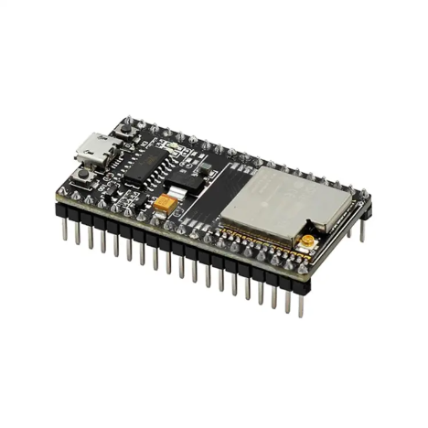
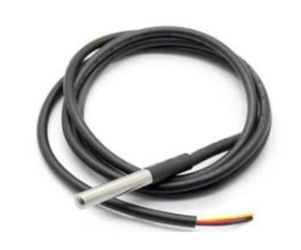
3.2 Design Methods (PO(a))
1. ESP32 WROOM Development module:
Processor: Dual-core 32-bit operating at a frequency of 80Mhz
RAM: 520kB
Power Supply: 2.2 – 3.6V
ADC 12-bit: 18
DAC 8-bit: 2
WiFi available
2. pH Sensor Analog Meter Kit:
Input Voltage: 5V
Accuracy: +-0.1pH
Response Time: <=1min
Operating Range: 0-14 pH
Presented by: 1906028

Slide 13
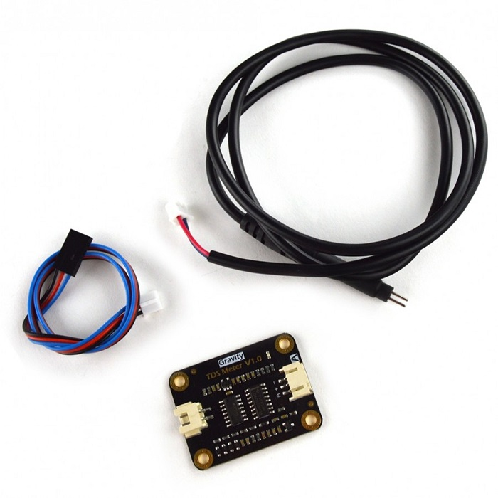
3.2 Design Methods (PO(a))
1. Gravity Analog TDS Sensor:
Input Voltage: 3.3 – 5.5 Volts
Output Voltage: 0 – 2.3 Volts
Working Current: 3 – 6 mA
TDS Measurement Range: 0 – 1,000 ppm
TDS Measurement Accuracy: ± 10% at 25°C
2. DS18B20 Temperature Sensor:
Temperature Measurement Range: -55°C to 125°C (-67 to 257°F)
Temperature Measurement Accuracy: ± 0.5 °C
Required Libraries: Dallas Temperature Sensor Library and One-Wire Library
4.7 kΩ resistor needed to be used as a pullup resistor between Data and V_{CC} line
Presented by: 1906028

Slide 14
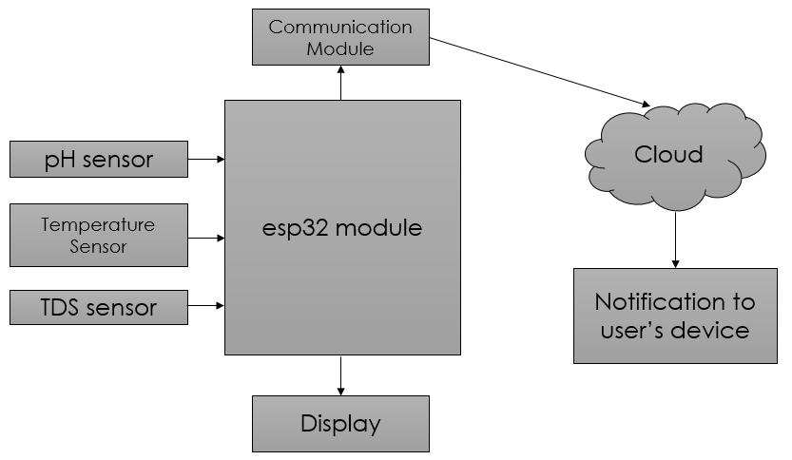
3.2 Design Methods (PO(a))
Flowchart:
Presented by: 1906028

Slide 15
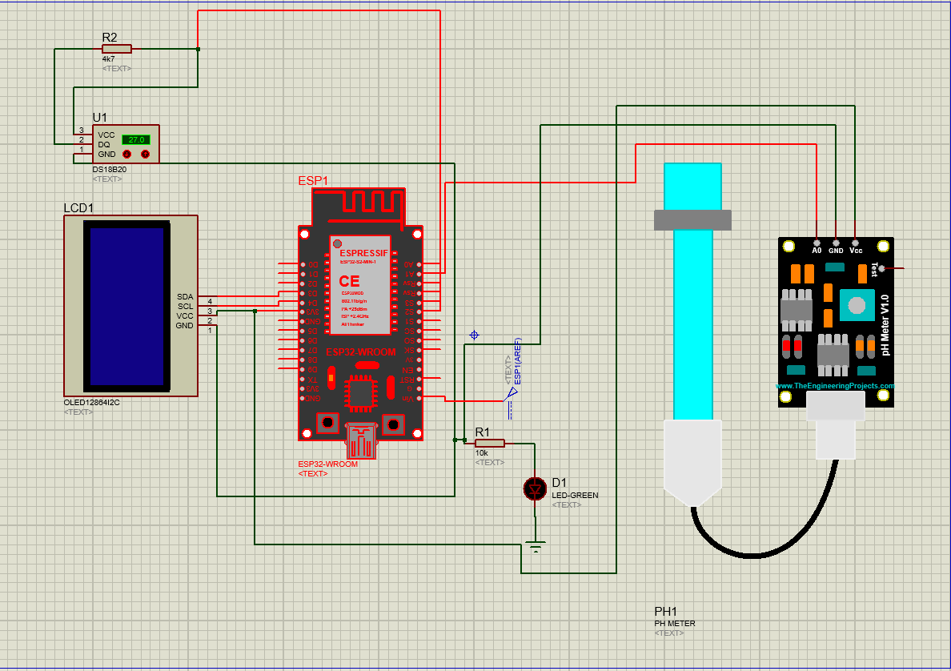
3.3 Design: Circuit Diagram
Presented by: 1906028

Slide 16
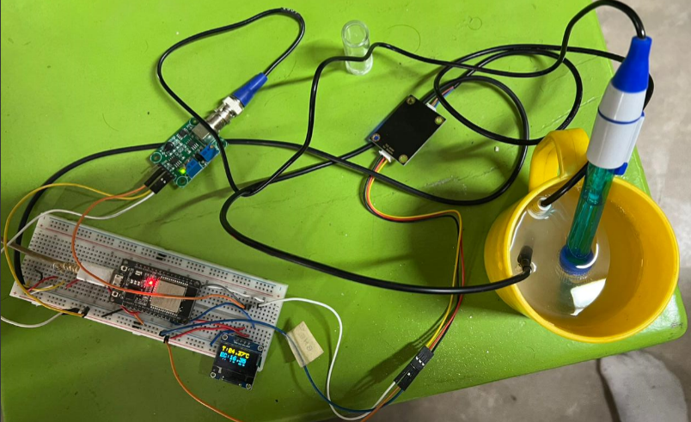
3.5 CAD/Hardware Design
Presented by: 1906028

Slide 17
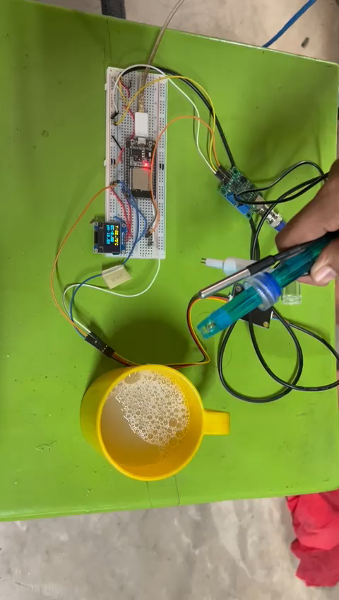
4 Implementation: Demonstration
Presented by: 1906016

Slide 18
4.1 Implementation: Photo Gallary(Hardware)
Presented by: 1906016

Slide 19
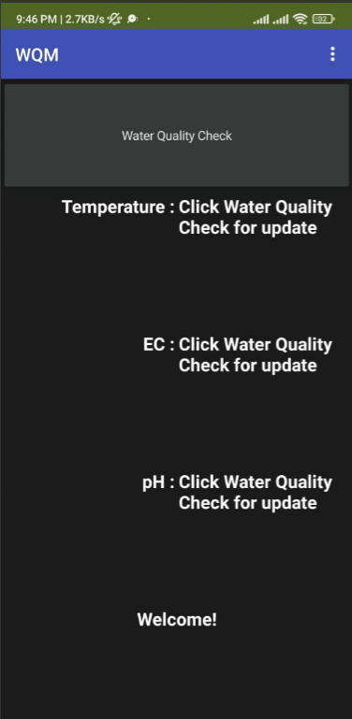
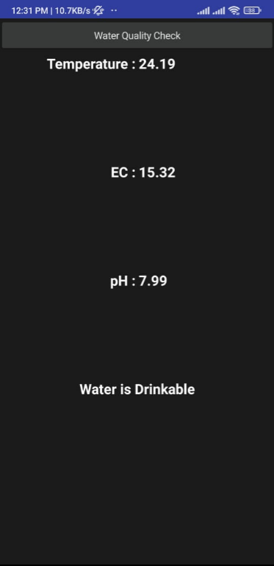
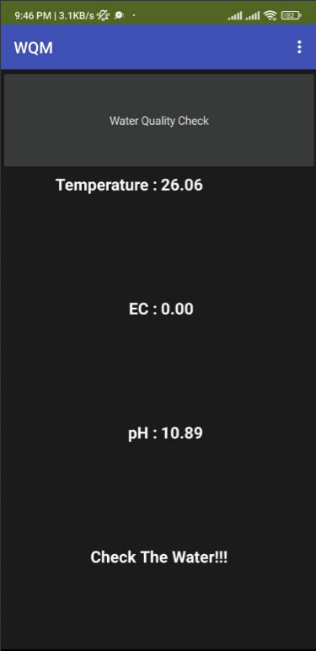
4.1 Implementation: Photo Gallary(Software)
Presented by: 1906016

Slide 20
5. Design Analysis and Evaluation
5.1 Novelty
5.2 Design Considerations (PO(c))
5.4 Limitations of Tools (PO(e))
Presented by: 1906016

Slide 21
5.1 Novelty
We combined various sensors like TDS sensor, pH sensor, temperature sensor.
We also designed an app for this project so that it can be a user friendly project.
Real time monitoring
Monitoring data stored in server
Presented by: 1906016

Slide 22
5.2 Design Considerations (PO(c))
5.2.1 Considerations to public health and safety
This project is completely designed for public health safety. It will help people to access safe water to drink.
5.2.2 Considerations to environment
The elements that is used for this project is not harmful for environment. So, there is no chance of environment pollution by this project.
5.2.3 Considerations to cultural and societal needs
This project is related to one of the basic need of human being. It gives valuable information about the water we drink. So, it also does a great help to the society.
Presented by: 1906024

Slide 23
5.4 Limitations of Tools (PO(e))
Sensitivity of the sensor can affect the result of the value
TDS sensor does not give the TDS of the sample water. It gives the value of electric conductivity. We do not get the exact value of how much dangerous element like arsenic, iron, copper etc. mixed with the water.
Presented by: 1906024

Slide 24
5.5 Impact Assessment (PO(f))
5.5.1 Assessment of Societal and Cultural Issues
The IoT-based water quality monitoring system enhances societal health by providing real-time data on water safety, reducing risks of waterborne diseases, and ensuring access to clean water, particularly in underserved communities. Culturally, it fosters environmental awareness and stewardship, encouraging communities to value and protect their natural resources.
5.5.2 Assessment of Health and Safety Issues
The project enhances health outcomes by continuously monitoring water quality parameters, thereby decreasing exposure to harmful pollutants and mitigating health risks associated with the consumption of contaminated water. Safety measures are strengthened through early detection of contaminants, facilitating quick responses to prevent health emergencies and ensuring the welfare of communities reliant on clean water sources.
Presented by: 1906024

Slide 25
5.5 Impact Assessment (PO(f)) Contd.
5.5.3 Assessment of Legal Issues
This project strengthens legal frameworks by providing real-time data on water quality, enabling authorities to enforce existing regulations more effectively and enact new laws based on comprehensive monitoring insights. It also enhances transparency and accountability in legal proceedings related to water pollution incidents, fostering trust in the legal system.
Presented by: 1906024

Slide 26
6. Reflection on Individual and Team work
6.1 Individual Contribution of Each Member
6.2 Mode of Teamwork
Presented by: 1906024

Slide 27
6.1 Individual Contribution of Each Member
ID | Contribution
1906002 | Worked in the hardware implementation, circuit debugging
1906016 | Worked on the software part, coding, debugging of the code
1906024 | Worked in the hardware implementation, circuit debugging
1906028 | Worked on the software part, coding, debugging of the code
Presented by: 1906024

Slide 28
6.2 Mode of Teamwork and Diversity
At the beginning of the project, we divided into two team.
One team looked at the hardware part, the other looked at the software part.
Each team had two member.
ID 1906002,1906024 worked on the hardware part.
ID 1906016,1906028 worked on the software part.
Everyone took part to develop the app and testing
Presented by: 1906024

Slide 29
7 Communication to External Stakeholders (PO(j))
GitHub Link:
https://github.com/rowatulrafi/IoT-based-Water-Quality-Monitoring
YouTube Link:
https://youtu.be/ZutYIcOhLQs?feature=shared
Presented by: 1906024

Slide 30
8. Project Management and Cost Analysis (PO(k))
Bill of Materials
Item | Cost (tk)
ESP32 Module | 420
TDS sensor | 1700
pH sensor | 2504
Temperature sensor | 700
OLED Display | 447
Breadboard | 150
Wire and Resistor | 50
Total | 5971

Slide 31
9. Future Work (PO(l))
Advance analytic model and decision support system can be integrated to interpret data and facilitate informed decision making.
Sensor calibration and data security can be improved.

Slide 32
10. References
https://how2electronics.com/iot-based-drinking-water-quality-monitoring-with-esp32/
https://how2electronics.com/ph-meter-using-ph-sensor-arduino-oled/
https://appinventor.mit.edu
Presented by: 1906024

Slide 33
Thank You
Presented by: 1906024

